Slide 1

Encoding multiple dimensions

Slide 2
Notes:
we’ve seen this 1000 times, but what makes it so powerful?
it encodes 5 dimensions of the data!
cite: tufte

Slide 3
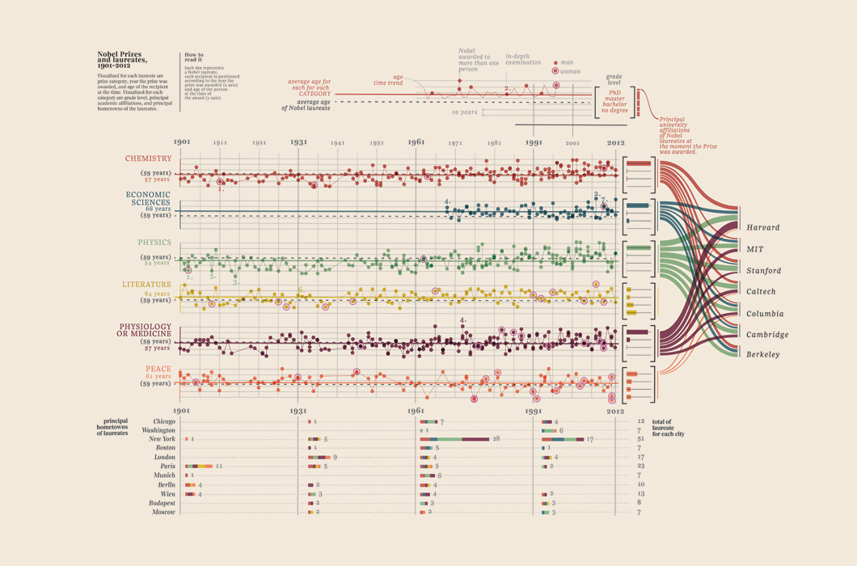
Notes:
given data with many dimensions: age, year, degree, gender, city, institution …what to encode and where?
cite: accurat

Slide 4
http://www.joshuastevens.net/cartography/make-a-bivariate-choropleth-map/
Notes:
given two variables….combining colors?

Slide 5
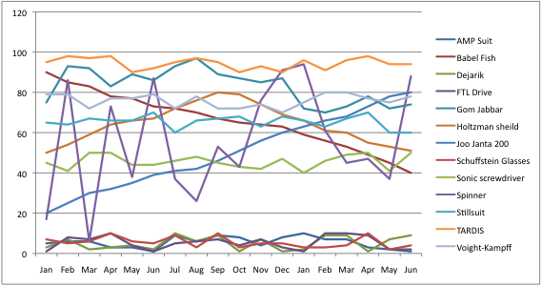

Slide 6
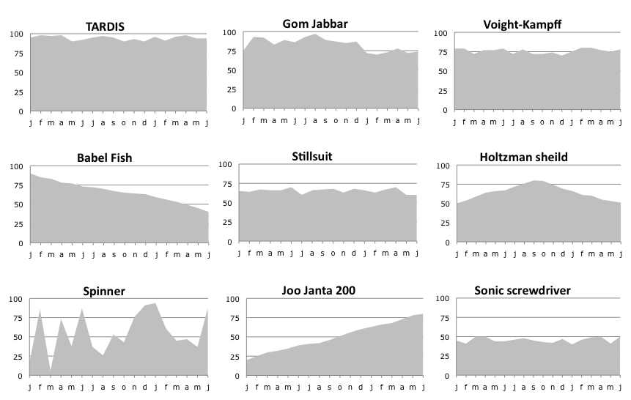

Slide 7
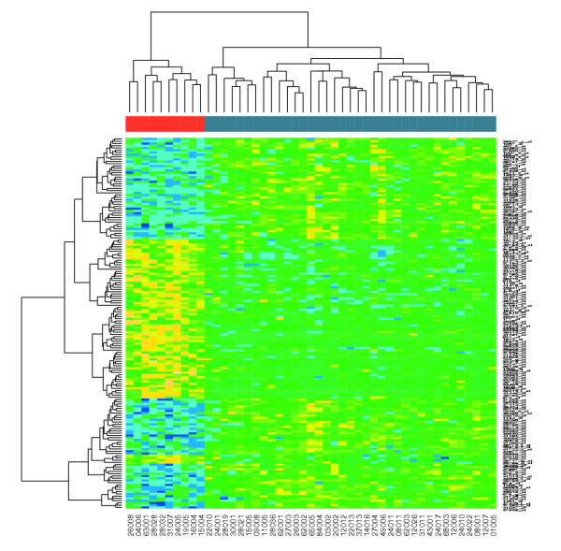

Slide 8
Back to perception
Notes:
identify what the audience/goals of a visualization are, and then turn to encoding that can accomplish those goals
making comparisons? best to use length first! get two spatial dimensions to start…

Slide 9
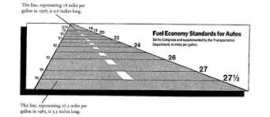
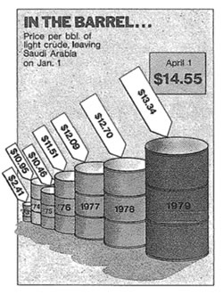
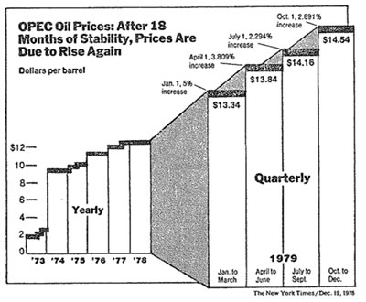
Another dimension?
Notes:
ah! distortion!!
(tufte)

Slide 10
Interaction to the rescue

Slide 11
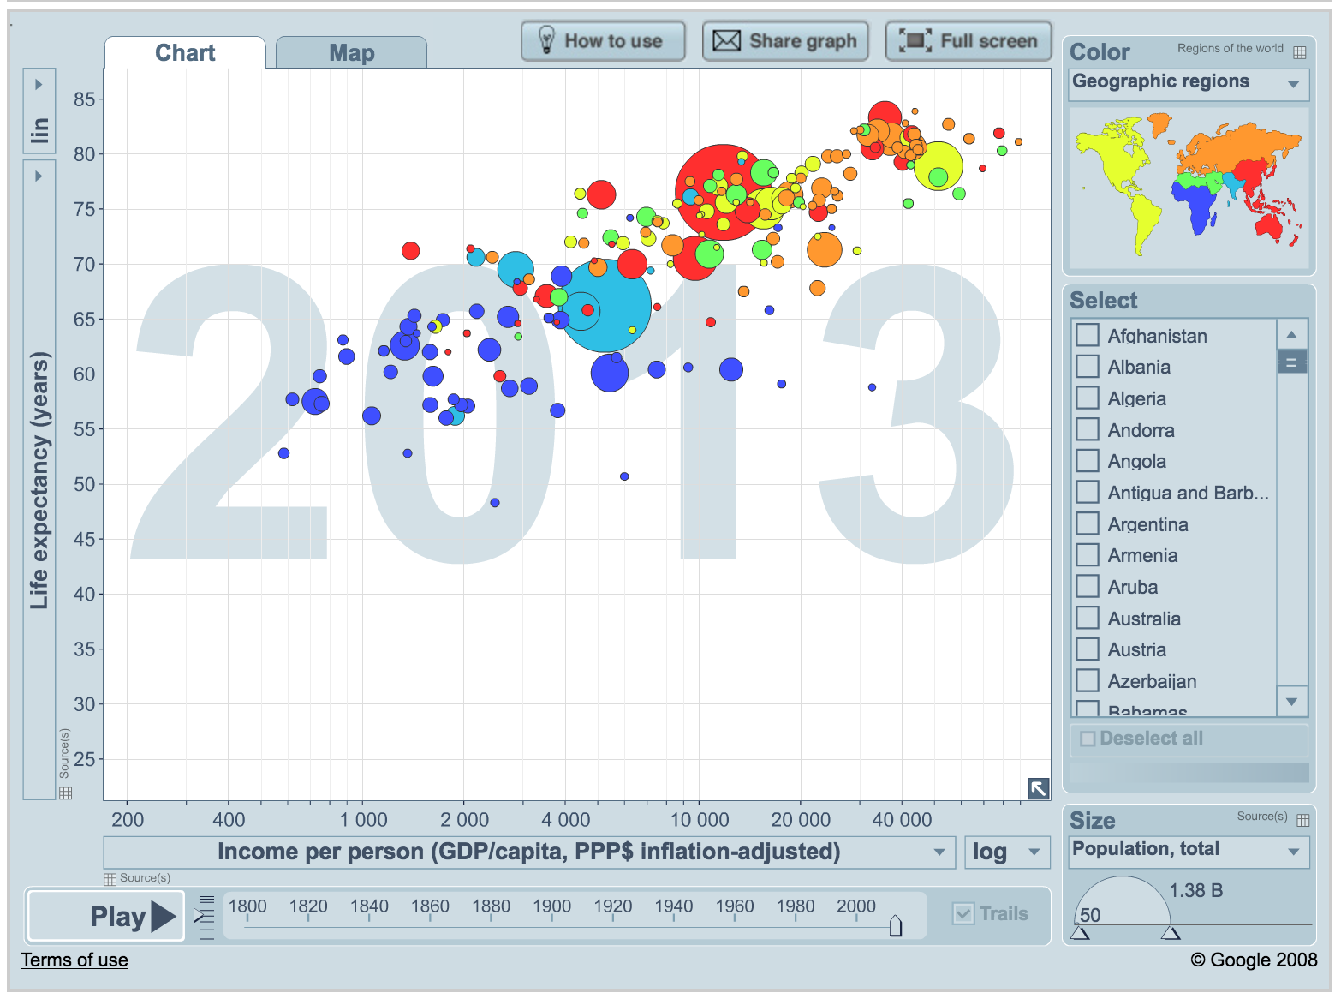
http://www.gapminder.org/world/
Notes:
include the video

Slide 12
Pitfalls of hover & animation
Notes:
don’t always accomplish the desired goals!
the goal of many variables is often to make _comparisons_
does not help much with explanatory- does help with exploratory (sometimes)

Slide 13
[ map with important data dimension in hover ]

Slide 14
[ clip of animation ]

Slide 15
Guiding principles for many dimensions
Notes:
seeing insights that don’t exist across single dimensions!
keep in mind the distinction between exploratory and explanatory

Slide 16


